Slide 1
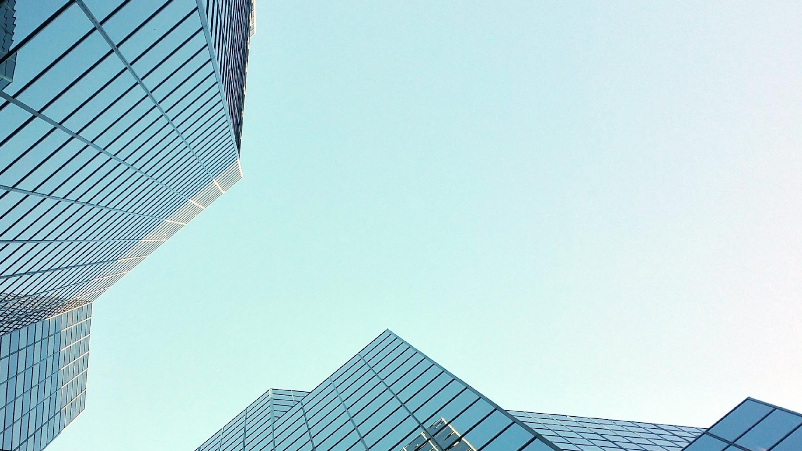
By: Eduardo Saldana, Goktug Cirag, Monty Oshinov
3P94 Final Project Presentation Group 16

Slide 2
Contents
1. Personas
2. Design
3. History of the Website
4. Feedback
5. Finished Product

Slide 3
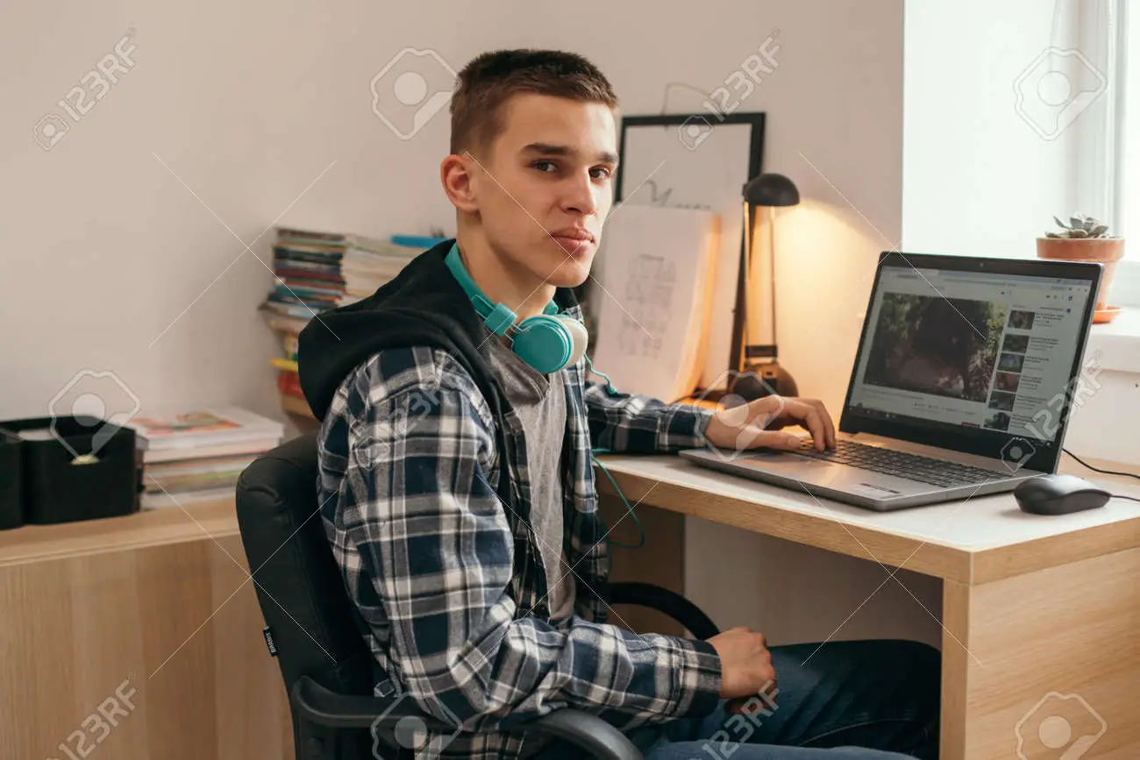
Primary Personas
Joey Johnson (15M)
Young but loves PC gaming. Owns an extensive collection of games but wants a computer that can run those games. He owns a PS4 and plays a lot of games on it but now that the new consoles have come out he has decided to get a new PC rather than get a PS5

Slide 4

Primary Personas
Akira (49F)
Akira immigrated recently along with her husband and son and is looking for a computer to browse the internet in her free time. She has a work visa working for a bank. After moving to Canada, she has had a huge pay raise working for the main branch of her bank. She misses her parents in Japan. Akira doesn’t have much free time, so she’s thinking of getting her son a computer to play with while she’s not around.

Slide 5

Primary Personas
Juan (21M)
He likes playing video games. He lives with his parents, but has started working to afford his gaming life. Juan wants to start playing on PC because none of his friends use Playstations anymore, and is currently saving up for a powerful build. He knows very little about computers and keeps asking his friend Arnold for advice.

Slide 6
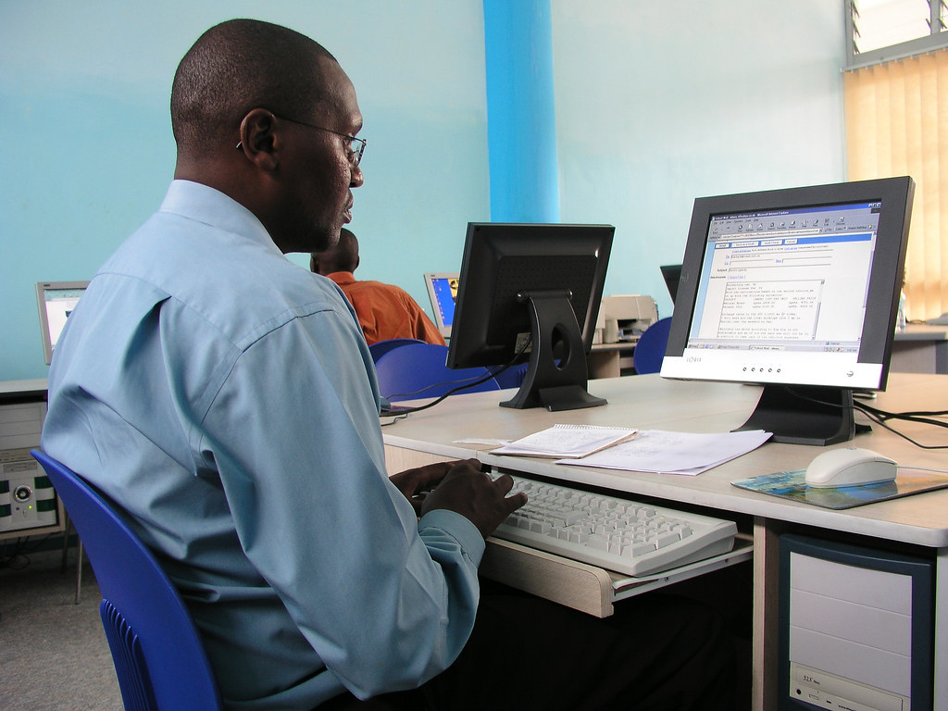
Primary Personas
Analysis
Analysing our Persona’s we came to a list of conclusions and groups in which we can categorize our groups. The main similarity is that our website aims for a demographic that is not necessarily very knowledgeable about PC parts but still has a general idea of what level of power they are looking for.
Groups of our demographic:
People looking to play videogames
People looking for a computer to business meetings
People looking for a computer to stay in contact with their family
People who need a computer for their work software

Slide 7
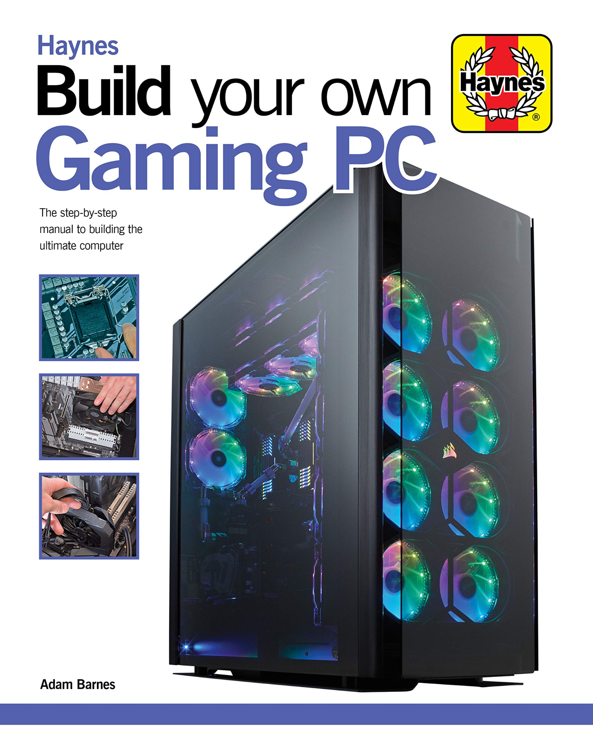
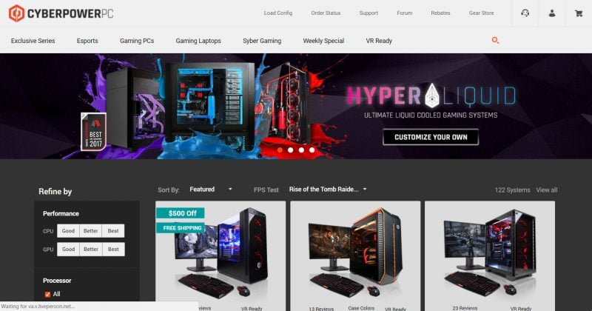
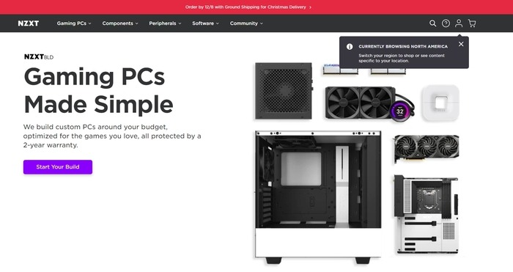
Drawing Inspiration

Slide 8
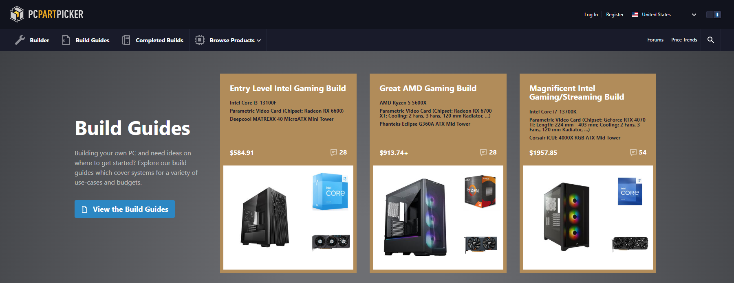
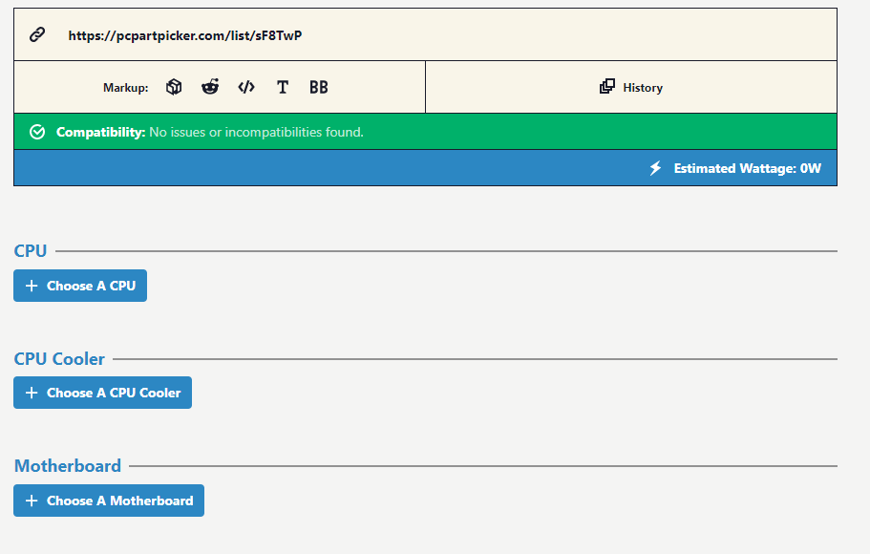
Breaking down websites
Front Page
Part Picker
Builder PC websites often feature a PC with a see thru case in its front page in its home page.
Builder PC websites usually list the parts to pick in order of “importance" and a clear separation
Nav Bar
The Nav bar always contains the logo followed by the different pages to the right and on the other side the login button and language option

Slide 9
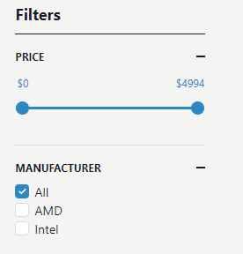
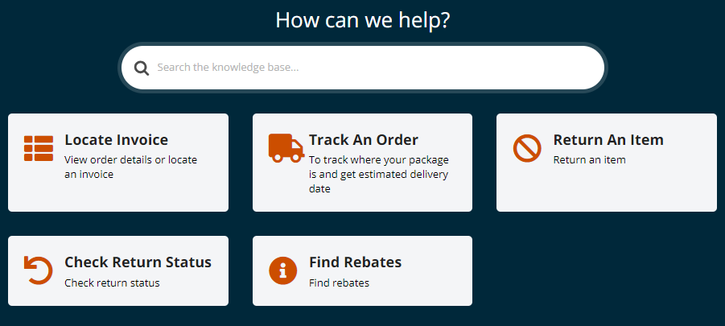
Breaking down websites
Filters
Customer Support
In every of this websites there is always an option to filter components by a variety of filters
Websites often offer the same basic options when it comes to PC building websites

Slide 10
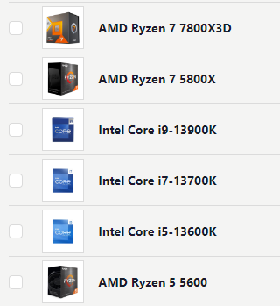
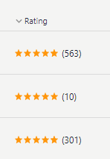
Pros and Cons to Observe
1.
2.
3.
1.
2.
3.
Con: PC Builder websites often felt overwhelming with all the visuals theuser was bombarded upon entering
Pro: Ratings were often present on PC components which is really useful to let the user feel more confident when making a purchase
Con: Displaying the different components often felt overwhelming as there was very little space betweneen them

Slide 11
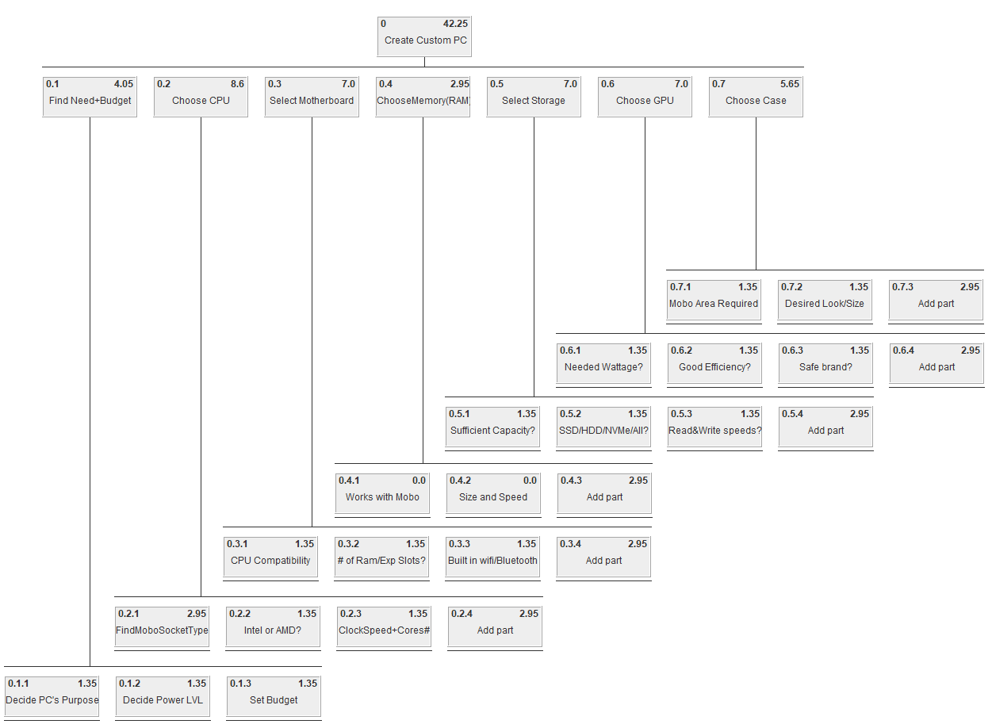
HTA
Based on our HTA’s the user will go through the following stages:
The user decides their needs
The user decides their budget
Choose CPU
Choose their Motherboard
Choose Memory
Choose their Storage
Choose CPU
Choose Case
Go to Checkout
Select Payment method
Pay

Slide 12
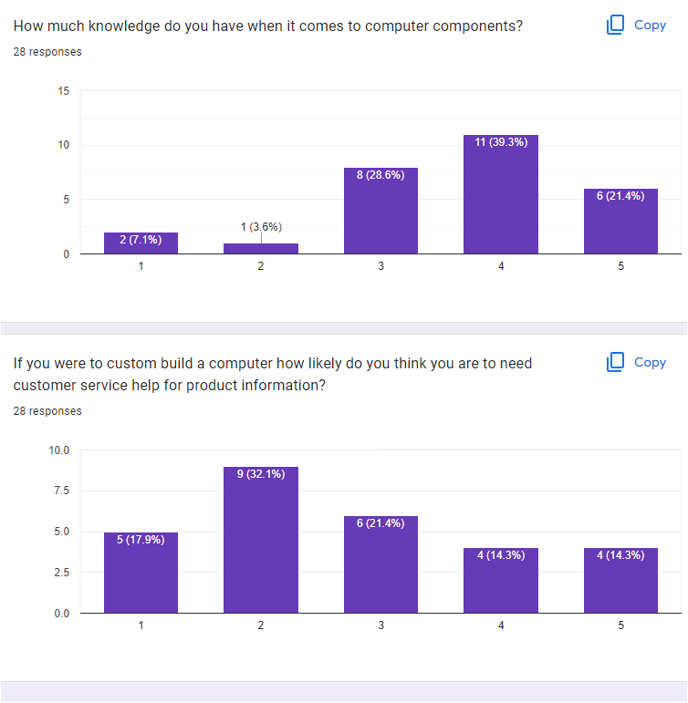
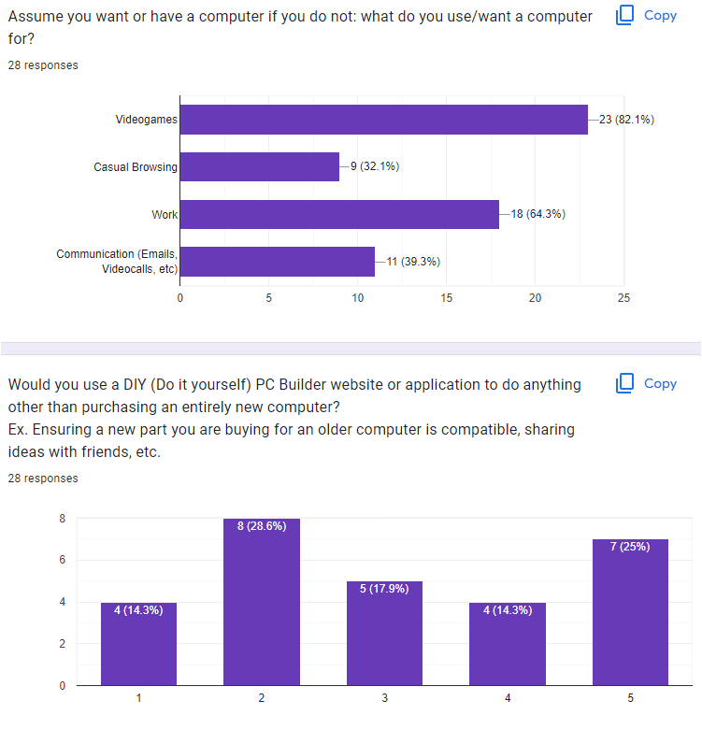
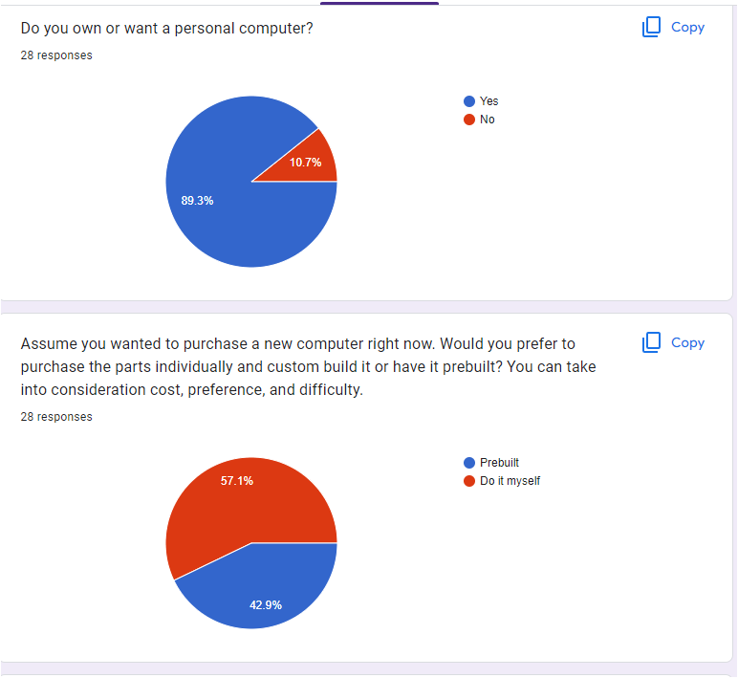
Survey Responses
The survey responses we got gave us a mixed response on what we could be looking for. Our pool mostly included our friends and thus our results were skewed towards a certain demographic. We decided to make the website to accommodate some of these people however. Even if the site was not going to be used for buying a fully built PC we could still sell parts and also have a builder to help users plan builds.

Slide 13
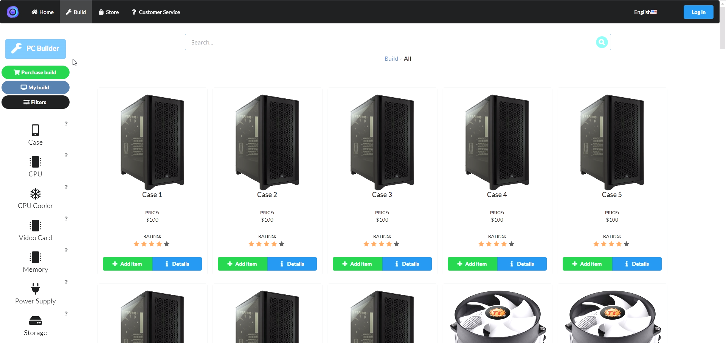
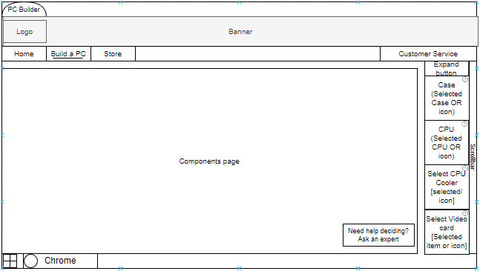
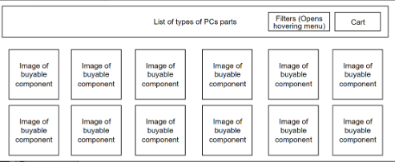
Rough Draft for Website
For the rough drafts we came up with a design that would work for a minimalist aesthetic. We wanted a layout that was simple and easy to read. We wanted a sidebar for our component buttons, choosing a component would dynamically showcase the different products per component rather than open a new page.
Our rough draft was similar to our final design. The rough draft for the PC Builder does not show off the component screen but it was visible in another rough draft.

Slide 14
Assumptions Made
Clear, Clean layout
Easy to use, nice on the eyes.
For this website we assumed that trying to appeal to everyone wasn’t the best idea. We needed to focus on people who know less about PC’s as they are more likely to use the site. We focused on a user friendly website for those not fully experienced with PC building. They would be able to use the website to build a PC easily, have some assistance with it and then order the PC to be built to their specifications. The layout is simple and clean, similar to widely used services like AirBnB and Amazon. The site doesn’t look like a gamer site, it has more of an Amazon look to it. The site is responsive and does not need to load a new page every time. This would help to encourage non-gamers to the site.
Focus on casuals
Gamers know PC’s, average people won't.
Responsive
No loading new pages every time,

Slide 15
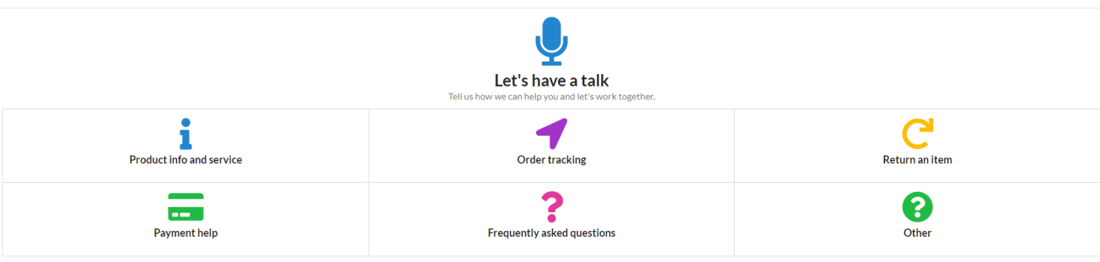
Changes Made based on Feedback
Search Bar
Change 1
Change 2
More vibrant design and better color coding.

Slide 16
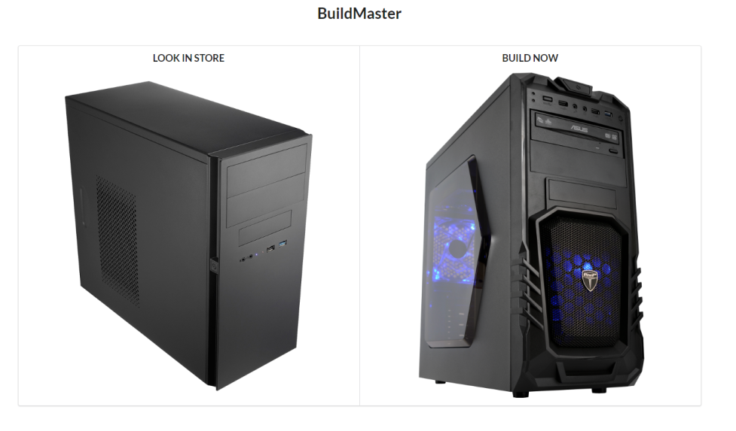
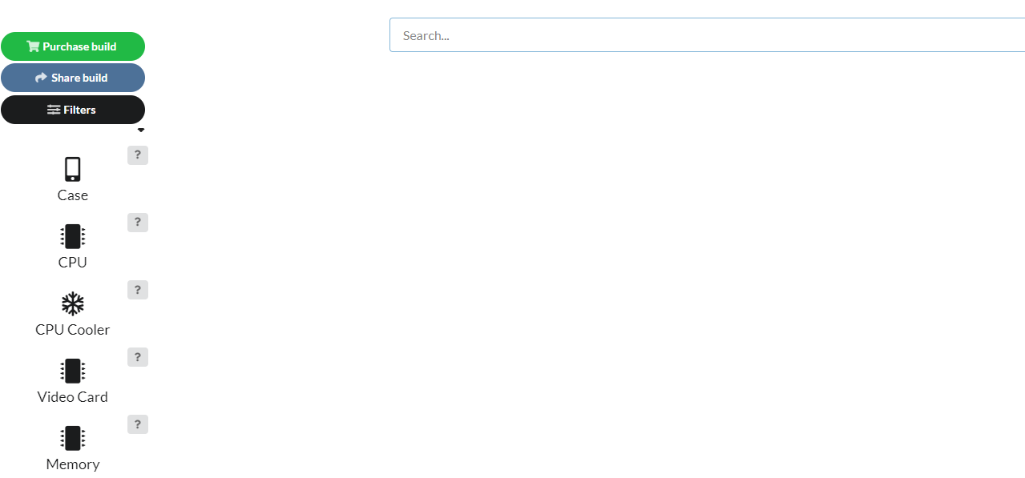
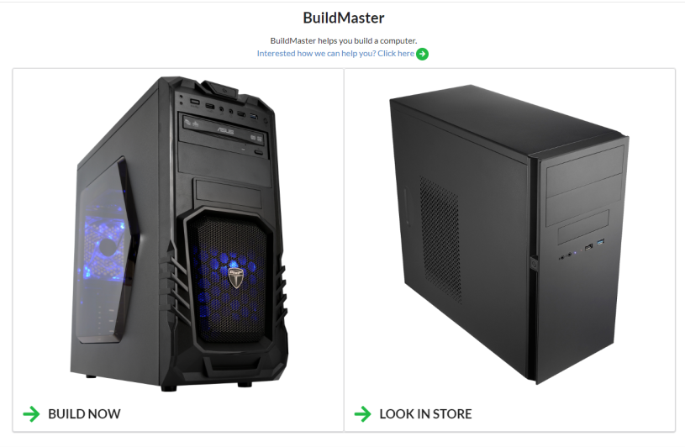
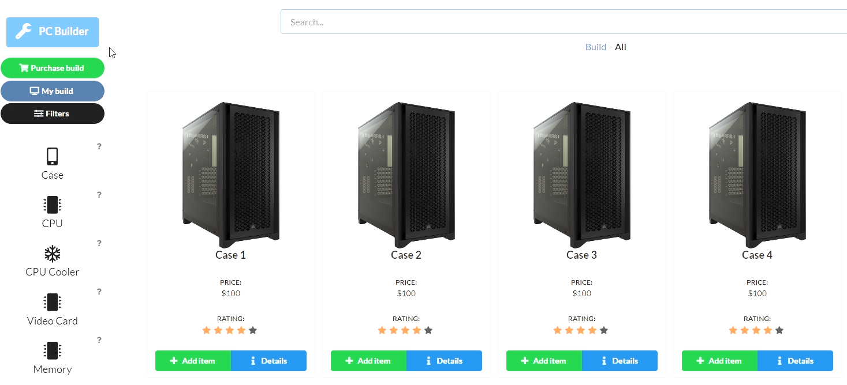
Better landing page
Change 3
Change 4
Optimized product display

